Slide 1
User Experience Design: Project #3 In-Car Financial Access for Royal Bank of Canada
Team:
Ameya Devbhankar, Chinmaya Kelkar, Pratik Walawalkar
Next

Slide 2
RBC In-Car Financial Access
Context of use :-
RBC In-Car financial Access will be used to find nearby ATM locations, check balance and perform other banking operations through the car infotainment system . Our car financial app is envisioned as an augmented version of regular RBC mobile application and it will be accessed through a medium like Android Auto or Apple Car play to ensure that it fits into existing RBC application ecosystem.
Next

Slide 3







RBC In-Car Financial Access
Royal Bank of Canada welcomes you!
To authenticate yourself, you need to record a phrase in your voice. To proceed click on next.
Next

Slide 4
RBC In-Car Financial Access
This feature will be implemented by the inbuilt car infotainment system.
Royal Bank of Canada welcomes you!
To authenticate yourself, you need to record a phrase in your voice. To proceed click on next.
Next

Slide 5
RBC In-Car Financial Access
You need to say the phrase
“I love the smell of coffee in the morning.”
When ready click on the microphone button or press OK.
OK

Slide 6
RBC In-Car Financial Access
Done!

Slide 7
RBC In-Car Financial Access
User authentication successful !
Done

Slide 8
Notifications
RBC ATM in 0.5 Miles
Auto Bill due on Monday
$100 withdrawal from ATM
$100 Sun pass recharged
Rent due for December

Slide 9
Enter your pattern
OK

Slide 10
Notifications
RBC ATM in 0.5 Miles
Auto bill due on Monday
$100 withdrawal from ATM
$100 Sun pass recharged
Rent due for December

Slide 11
Enter your pattern
OK

Slide 12
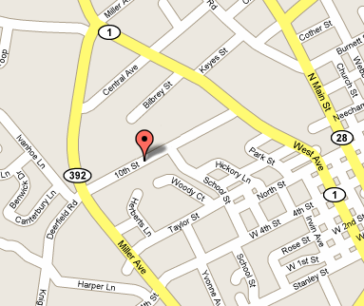

ATM Locations
3800 SW 34th Street, Gainesville

Slide 13
Balance
A/C No: 1221356
Checking Account
$500.23
RBC Wallet
Wallet Balance
$100.76
A/C No: 1221356
Savings Account
$560.34
RBC Credit Card
Card Balance
$240.23

Slide 14
Pay Bills
Auto Bill
Account ****356
Due Date: 12/11/17 $150.23
Apartment Rent
Account ****356
Due Date:11/11/17 $200
Sun pass Recharge
Account ****356
Due Date:11/11/17 $100

Slide 15
Pay Bills
Netflix payment
Account ****356
Due Date: 12/11/17 $25
Apartment Rent
Account ****356
Due Date:11/11/17 $200
Sun pass Recharge
Account ****356
Due Date:11/11/17 $100

Slide 16
Transfer Funds
A/C No: 1221356
Checking Account
$500.23
A/C No: 1221356
Savings Account
$560.34

Slide 17
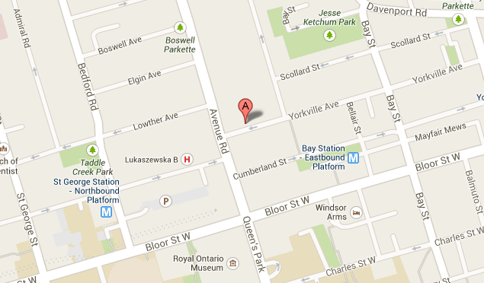
Gas Stations
3800 SW 34th Street, Gainesville

Slide 18
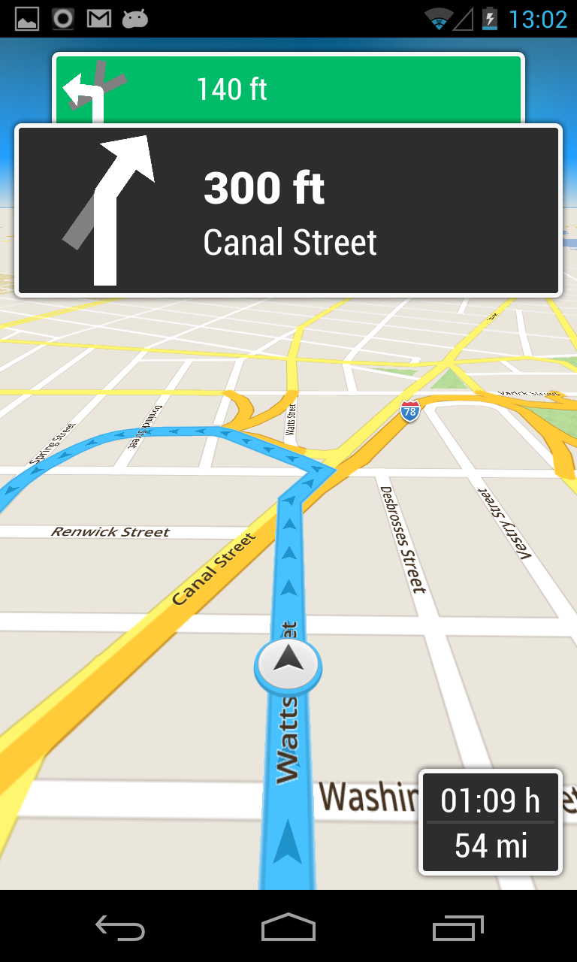
ATM Locations
Get Code

Slide 19
ATM Locations
Code Sent to Mobile Phone Successfully
$200
Get Code

Slide 20
Balance
A/C No: 1221356
Checking Account
$500.23
RBC Wallet
Wallet Balance
$100.76
Description | Credit | Debit
ATM Withdrawal |  | $100
Save as you go credit | $2
Rent |  | $200
A/C No: 1221356
Savings Account
$560.34
RBC Credit Card
Card Balance
$240.23

Slide 21
Balance
A/C No: 1221356
Checking Account
$500.23
RBC Wallet
Wallet Balance
$100.76
Description | Credit | Debit
Sun pass Recharge |  | $100
Save as you go credit | $2
Electricity bill |  | $200
A/C No: 1221356
Savings Account
$560.34
RBC Credit Card
Card Balance
$240.23

Slide 22
Balance
A/C No: 1221356
Checking Account
$500.23
RBC Wallet
Wallet Balance
$100.76
Description | Credit | Debit
Best Buy | $200
Credit Card Payment |  | $250
Electricity bill | $100
A/C No: 1221356
Savings Account
$560.34
RBC Credit Card
Card Balance
$240.23

Slide 23
Balance
A/C No: 1221356
Checking Account
$500.23
RBC Wallet
Wallet Balance
$100.76
Description | Credit | Debit
Blaze Pizza Bill | $20
Wallet Card Payment |  | $25
Sprint Bill | $100
A/C No: 1221356
Savings Account
$560.34
RBC Credit Card
Card Balance
$240.23

Slide 24
Pay Bills
Auto Bill
Account ****356
Due Date: 12/11/17 $150.23
Account ****356
Apartment Rent
Account ****356
Due Date:11/11/17 $200
Pay
Sun pass Recharge
Account ****356
Due Date:11/11/17 $100

Slide 25
Pay Bills
Auto Bill
Account ****356
Due Date: 12/11/17 $150.23
Payment Successful
Apartment Rent
Account ****356
Due Date:11/11/17 $200
Sun pass Recharge
Account ****356
Due Date:11/11/17 $100

Slide 26
Transfer Funds
A/C No: 1221356
Checking Account
$500.23
A/C No: 1221356
Checking Account
$500.23
A/C No: 1221356
Savings Account
$560.34

Slide 27
Transfer Funds
A/C No: 1221356
Checking Account
$500.23
A/C No: 1221356
Savings Account
$560.34
A/C No: 1221356
Savings Account
$560.34

Slide 28
Transfer Funds
A/C No: 1221356
Checking Account
$500.23
A/C No: 1221356
Enter Amount
A/C No: 1221356
Savings Account
$560.34
A/C No: 1221356
Savings Account
$560.34
Transfer

Slide 29
Transfer Funds
Transfer Successful
A/C No: 1221356
Checking Account
$500.23
A/C No: 1221356
Enter Amount
$100
A/C No: 1221356
Savings Account
$560.34
A/C No: 1221356
Savings Account
$560.34
Transfer

Slide 30
Transfer Funds
A/C No: 1221356
Checking Account
$500.23
A/C No: 1221356
Enter Amount
A/C No: 1221356
Savings Account
$560.34
A/C No: 1221356
Checking Account
$560.34
Transfer

Slide 31
Transfer Funds
Transfer Successful
A/C No: 1221356
Checking Account
$500.23
A/C No: 1221356
Enter Amount
$120
A/C No: 1221356
Savings Account
$560.34
A/C No: 1221356
Checking Account
$560.34
Transfer

Slide 32
Gas Station Locations
Get Code

Slide 33
Gas Station Locations
Code Sent to Mobile Phone Successfully
Get Code

Slide 34
Pay Bills
Auto Bill
Account ****356
Due Date: 12/11/17 $150.23
Account ****356
Apartment Rent
Account ****356
Due Date:11/11/17 $200
Pay
Sun pass Recharge
Account ****356
Due Date:11/11/17 $100

Slide 35
Pay Bills
Auto Bill
Account ****356
Due Date: 12/11/17 $150.23
Account ****356
Apartment Rent
Account ****356
Due Date:11/11/17 $200
Pay
Sun pass Recharge
Account ****356
Due Date:11/11/17 $100

Slide 36
Pay Bills
Payment Successful
Auto Bill
Account ****356
Due Date: 12/11/17 $150.23
Apartment Rent
Account ****356
Due Date:11/11/17 $200
Sun pass Recharge
Account ****356
Due Date:11/11/17 $100

Slide 37
Pay Bills
Auto Bill
Account ****356
Due Date: 12/11/17 $150.23
Account ****356
Apartment Rent
Account ****356
Due Date:11/11/17 $200
Pay
Sun pass Recharge
Account ****356
Due Date:11/11/17 $100

Slide 38
Pay Bills
Payment Successful
Auto Bill
Account ****356
Due Date: 12/11/17 $150.23
Apartment Rent
Account ****356
Due Date:11/11/17 $200
Sun pass Recharge
Account ****356
Due Date:11/11/17 $100

Slide 39
This feature will be implemented by the inbuilt car infotainment system.

Slide 40
This feature will be implemented by voice recognition functionality of car infotainment system such as Siri in Apple Car Play

